Slide 1
Analytical and Numerical Solution in The One-Dimensional Ising Model
University of Seoul – Department of Physics
2022. 08. 25.
2021550026
전성배

Slide 2
Concept
1. Analytical Solution in The One-Dimensional Ising Model
1-1. Introduction to Ising Model
1-2. Partition Function
1-3. Energy, Magnetization, Heat Capacity, Susceptibility
2. Numerical Solution in The One-Dimensional Ising Model
2-1. Monte Carlo Method
2-2. Markov Chain
2-3. Markov Chain Monte Carlo(MCMC) and Metropolis Algorithm
2-4. Application Metropolis Algorithm to The One-Dimensional Ising Model
2-5. Detailed Balance
2-6. Python Code
2-7. Result
2-8. Comparison of Analytical and Numerical Solution
3. Reference

Slide 3
1. Analytical Solution in The One-Dimensional Ising Model
1-1. Introduction to Ising Model
A simple but fundamental model that takes interaction only between nearest-neighbor spins into account
In Ising model, there are only up and down spins.
Fig. 1.1. The one-dimensional Ising model
Fig. 1.2. The two-dimensional Ising model

Slide 4


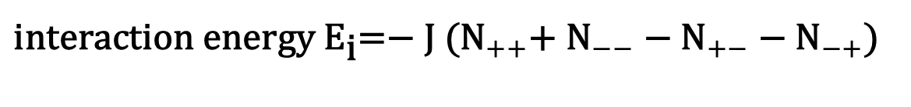
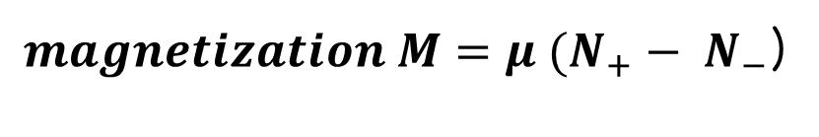

1. Analytical Solution in The One-Dimensional Ising Model
Fig. 1.3. Parallel links
Fig. 1.4. Antiparallel links
The energy of parallel link is $−J$
The energy of antiparallel link is $+J$
${N=N}_{+}+N_{−}$
${magnetization M=μ (N}_{+}− N_{−}$)
${{{\text{interaction} \text{energy} {\text{E}}_{\text{i}}\text{=}\text{− }\text{J}\text{ (}\text{N}}_{++}\text{+} \text{N}}_{−−} \text{−} \text{N}}_{+−}{ \text{− }\text{N}}_{−+}$)

Slide 5

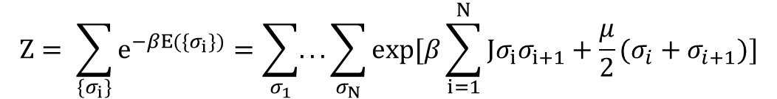
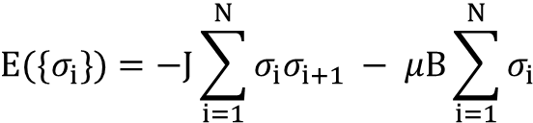
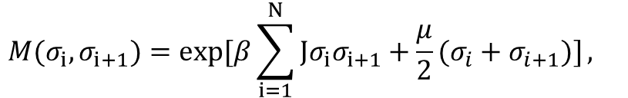
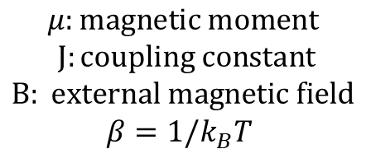
1. Analytical Solution in The One-Dimensional Ising Model
1-2. Partition Function
$$E(\{σ_{i}\})=−J\sum_{i=1}^{N}{σ_{i}σ_{i+1} − μB\sum_{i=1}^{N}{σ_{i}}}$$
$$μ:magnetic moment$$
$$J:coupling constant$$
$$B: external magnetic field$$
$$β=1/k_{B}T$$
$$Z= \sum_{\{σ_{i}\}}{e^{−βE(\{σ_{i}\})}=\sum_{σ_{1}}{...\sum_{σ_{N}}{exp[β\sum_{i=1}^{N}{Jσ_{i}σ_{i+1}+\frac{μ}{2}(σ_{i}+σ_{i+1})}]}}}$$
by periodic boundary condition
$${M(σ}_{i}{,σ_{i+1})=exp[β\sum_{i=1}^{N}{Jσ_{i}σ_{i+1}+\frac{μ}{2}(σ_{i}+σ_{i+1})]}, }_{}$$
$$A=\left(\begin{matrix}e^{β+h} & e^{−βJ} \\ e^{−βJ} & e^{β\left(J+h\right)}\end{matrix}\right)$$
$$Z=\sum_{σ_{1}}{...\sum_{σ_{N}}{A_{σ_{1,},σ_{2,}}A_{σ_{2},σ_{3,}}…A_{σ_{N−1},σ_{N}}A_{σ_{N},σ_{1}}=tr\left(A^{N}\right)=tr\left(A_{diag}^{N}\right)={\left(\begin{matrix}λ_{1} & 0 \\ 0 & λ_{2}\end{matrix}\right)}^{N}=λ_{1}^{N}+λ_{2}^{N}}}$$
$$=$$

Slide 6
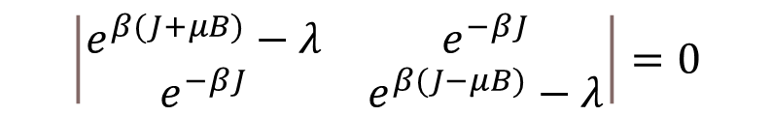
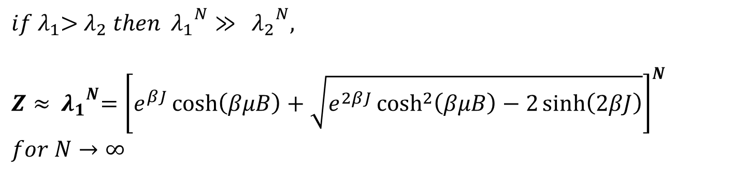
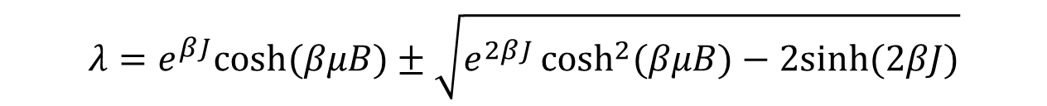
1. Analytical Solution in The One-Dimensional Ising Model
$$\left|A−λI\right|=0$$
$$\left|\begin{matrix}e^{β(J+μB)}−λ & e^{−βJ} \\ e^{−βJ} & e^{β(J−μB)}−λ\end{matrix}\right|=0$$
$$λ=e^{βJ}cosh⁡(βμB)±\sqrt{e^{2βJ}\cosh^{2}{(βμB)−2sinh⁡(2βJ)}}$$
$if{ λ}_{1}$> $λ_{2} then{ λ_{1}}^{N}≫$ ${ λ_{2}}^{N},$
$$Z≈{ λ_{1}}^{N}={\left[e^{βJ}\cosh\left(βμB\right)+\sqrt{e^{2βJ}\cosh^{2}\left(βμB\right)−2\sinh\left(2βJ\right)}\right]}^{N}$$
$$for N→∞$$

Slide 7

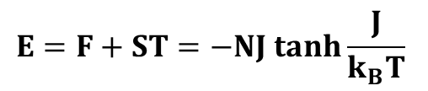
1. Analytical Solution in The One-Dimensional Ising Model
1-3. Energy, Heat Capacity, Magnetization and Susceptibility
Free energy
$$F=−k_{B}Tln\left[Z\right]=−Nk_{B}Tln[e^{βJ}\cosh\left(βμB\right)+\sqrt{e^{2βJ}\cosh^{2}\left(βμB\right)−2\sinh\left(2βJ\right)}]$$
Entropy at B = 0
$$F=−k_{B}Tln\left[Z\right]=−Nk_{B}Tln\left[e^{βJ}+e^{−βJ}\right]=−Nk_{B}Tln[2coshβJ]$$
$$S=−\frac{∂F}{∂T}=Nk_{B}\left[\ln\left(2cosh\frac{J}{k_{B}T}\right)−\frac{J}{k_{B}T}\left(tanh\frac{J}{k_{B}T}\right)\right]$$
$$E=F+ST=−NJ tanh\frac{J}{k_{B}T}$$

Slide 8
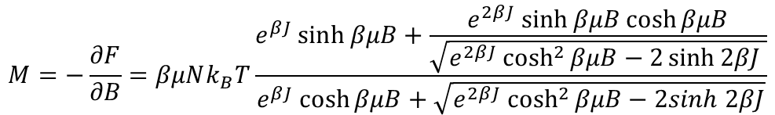
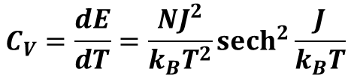

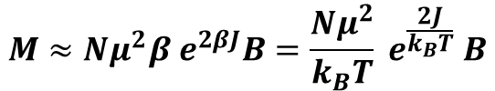
1. Analytical Solution in The One-Dimensional Ising Model
Heat Capacity at B = 0
$$C_{V}=\frac{dE}{dT}=\frac{NJ^{2}}{k_{B}T^{2}}{sech}^{2}{\frac{J}{k_{B}T}}$$
Magnetization
$$M=−\frac{∂F}{∂B}=βμNk_{B}T\frac{e^{βJ}\sinh{βμB}+\frac{e^{2βJ}\sinh{βμB}\cosh{βμB}}{\sqrt{e^{2βJ}\cosh^{2}{βμB−2\sinh{2βJ} }}}}{e^{βJ}\cosh{βμB+\sqrt{e^{2βJ}\cosh^{2}{βμB}−2sinh 2βJ}}}$$
In a weak magnetic field $\sinh{βμB}≈1,\cosh{βμB≈1}$
$$M≈Nμ^{2}β e^{2βJ}B=\frac{Nμ^{2}}{k_{B}T} e^{\frac{2J}{k_{B}T}} B$$
Susceptibility
$$χ=μ_{0}\frac{Nμ^{2}}{k_{B}T} e^{\frac{2J}{k_{B}T}} B$$

Slide 9
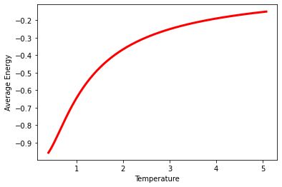
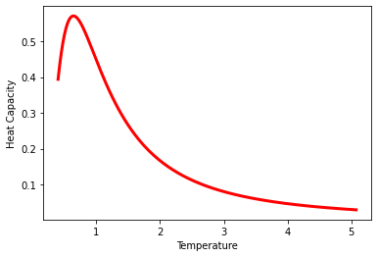
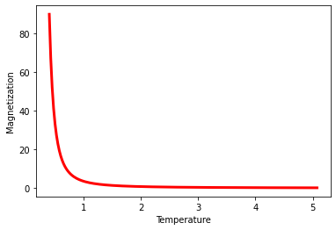
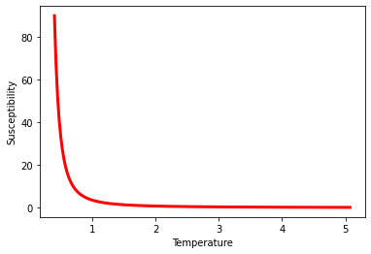
1. Analytical Solution in The One-Dimensional Ising Model
Graph
Fig. 1.4. Analytical solution graph in the one-dimensional Ising model

Slide 10
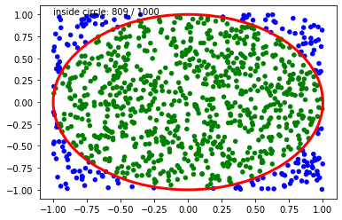
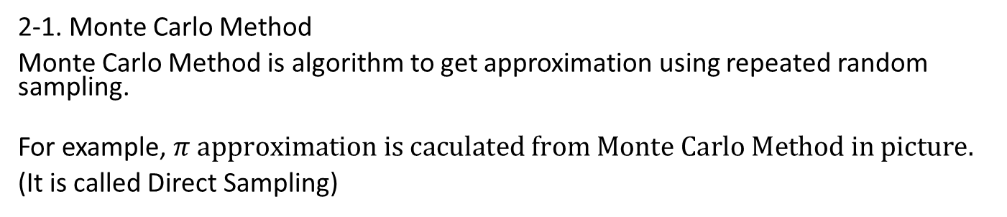
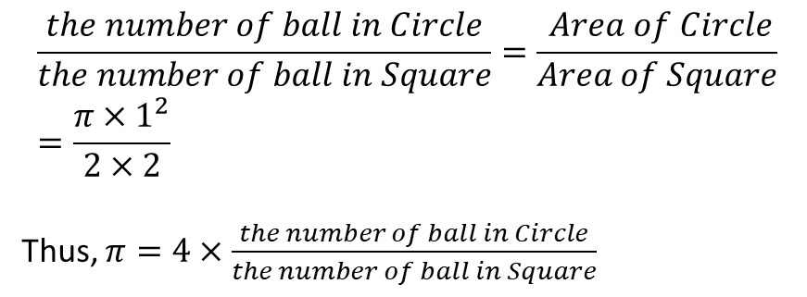
2. Numerical Solution in The One-Dimensional Ising Model
2-1. Monte Carlo Method
Monte Carlo Method is algorithm to get approximation using repeated random sampling.
For example, $π approximation is caculated from Monte Carlo Method in picture.$
(It is called Direct Sampling)
$$\frac{the number of ball in Circle}{the number of ball in Square}=\frac{ Area of Circle}{Area of Square}=\frac{π{×1}^{2}}{2×2}$$
Thus, $π=4×\frac{the number of ball in Circle}{the number of ball in Square}$
Fig. 2.1. pi approximation by Monte Carlo method

Slide 11
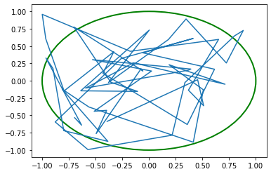


2. Numerical Solution in The One-Dimensional Ising Model
2-2. Markov Chain (MC)
Markov Chain Model is probabilistic model that present situation is only depended on last situation. After repeating, it reaches Stationary Distribution.
For example, $π$ approximation can be calculated from Markov Chain.
Start at (-1,-1) and Add random number between -1 and 1 each x and y coordinates.
If new coordinate is inside square (that x, y is from -1 to 1), new coordinate is saved.
If not, last coordinate is maintained.
And count the number of inside the circle.
$$π=4×\frac{counted number }{total trial}$$
Fig. 2.2. pi approximation by Markov Chain

Slide 12
2. Numerical Solution in The One-Dimensional Ising Model
2-3. Markov Chain Monte Carlo (MCMC) and Metropolis Algorithm
Markov Chain + Monte Carlo
=
(Repeated random sampling)
+ (State only dependent on last state)
One simple example of Markov Chain Monte Carlo(MCMC) is
Metropolis Algorithm.

Slide 13
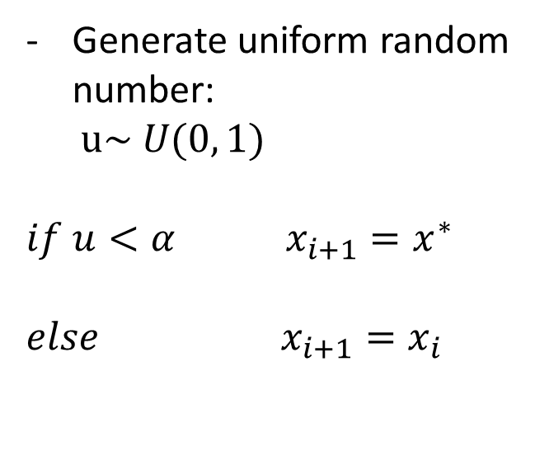
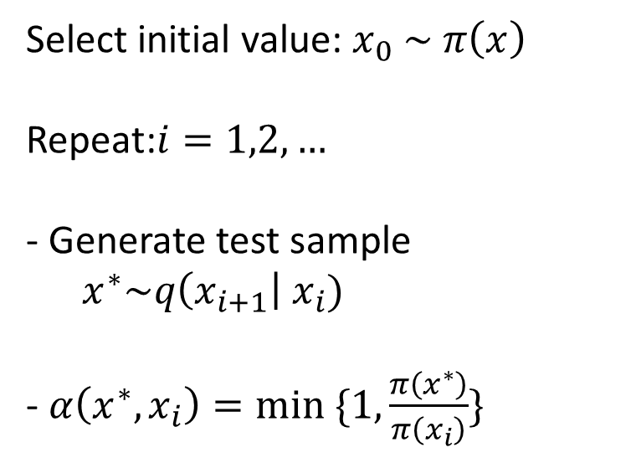
2. Numerical Solution in The One-Dimensional Ising Model
Metropolis Algorithm
Select initial value: $x_{0} \sim π\left(x\right)$
Repeat:$i=1,2,…$
- Generate test sample
$x^{∗}\sim q\left(x_{i+1}\right| x_{i})$
- $α\left(x^{∗}, x_{i}\right)=min ⁡\{1, \frac{π\left(x^{∗}\right)}{π\left(x_{i}\right)}\}$
Generate uniform random
number:
$$u\sim U(0, 1)$$
$$if u<α x_{i+1}=x^{∗}$$
$$else x_{i+1}=x_{i}$$

Slide 14
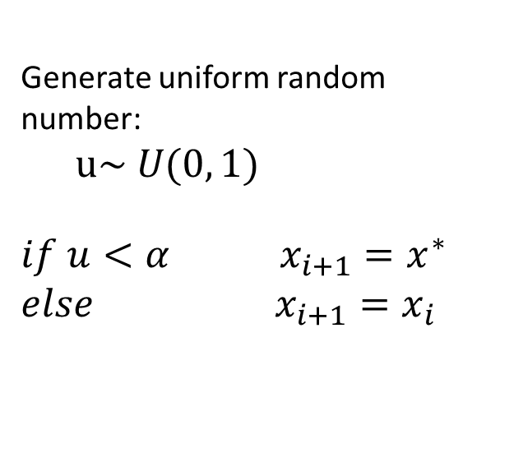

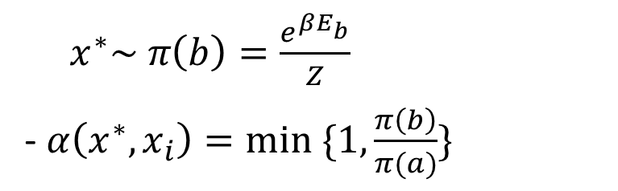
2. Numerical Solution in The One-Dimensional Ising Model
2-4. Application Metropolis Algorithm to The One-Dimensional Ising Model
$x^{∗}\sim π\left(b\right)=\frac{e^{βE_{b}}}{Z}$
- $α\left(x^{∗}, x_{i}\right)=min ⁡\{1,\frac{π\left(b\right)}{π(a)}\}$
Select initial value: $x_{0} \sim π\left(a\right)$
$$π\left(a\right)=\frac{e^{βE_{a}}}{Z},$$
Flip and get $π\left(b\right)$
(Boltzmann distribution)
Generate uniform random
number:
$$u\sim U(0, 1)$$
$$if u<α x_{i+1}=x^{∗}$$
$$else x_{i+1}=x_{i}$$
Fig. 2.3. Flip in

Slide 15

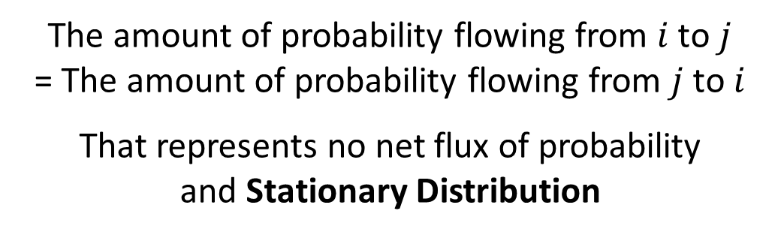

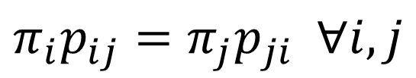






2. Numerical Solution in The One-Dimensional Ising Model
2-5. Detailed balance
$$k$$
$$i$$
$$j$$
$$i$$
$$p_{ij}$$
$$j$$
$$p_{ji}$$
$$p_{ji}$$
Fig. 2.5. Global balance diagram
Fig. 2.4. Detailed balance diagram
$$π_{i}p_{ij}=π_{j}p_{ji} ∀i,j$$
The amount of probability flowing from $i$ to $j$
= The amount of probability flowing from $j$ to $i$
That represents no net flux of probability
and Stationary Distribution

Slide 16
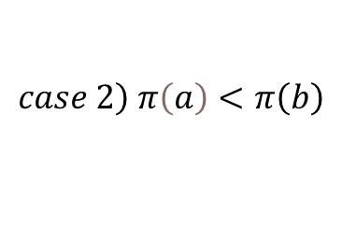

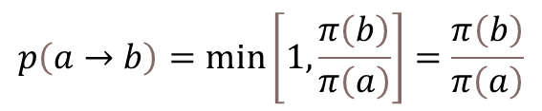




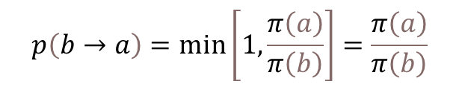
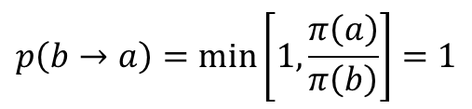


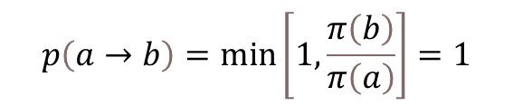
2. Numerical Solution in The One-Dimensional Ising Model
$$\left.case 1\right) π\left(a\right)>π\left(b\right)$$
$$\left.case 2\right) π\left(a\right)<π\left(b\right)$$
$$p\left(a→b\right)=\min\left[1,\frac{π\left(b\right)}{π\left(a\right)}\right]=\frac{π\left(b\right)}{π\left(a\right)}$$
$$p\left(a→b\right)=\min\left[1,\frac{π\left(b\right)}{π\left(a\right)}\right]=1$$
$$⇒π\left(a\right)p\left(a→b\right)=π\left(b\right)$$
$$⇒π\left(a\right)p\left(a→b\right)=π\left(a\right)$$
$$p\left(b→a\right)=\min\left[1,\frac{π\left(a\right)}{π\left(b\right)}\right]=1$$
$$p\left(b→a\right)=\min\left[1,\frac{π\left(a\right)}{π\left(b\right)}\right]=\frac{π\left(a\right)}{π\left(b\right)}$$
$$⇒π\left(b\right)p\left(b→a\right)=π\left(b\right)$$
$$⇒π\left(b\right)p\left(b→a\right)=π\left(a\right)$$
$$∴π\left(a\right)p\left(a→b\right)=π\left(b\right)P\left(b→a\right)$$
$$∴π\left(a\right)p\left(a→b\right)=π\left(b\right)P\left(b→a\right)$$

Slide 17
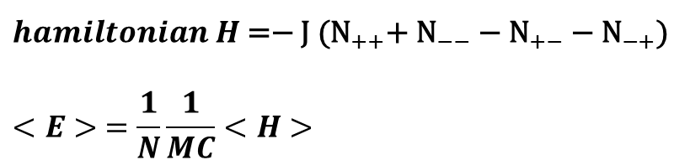
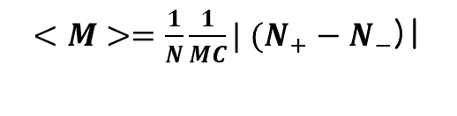
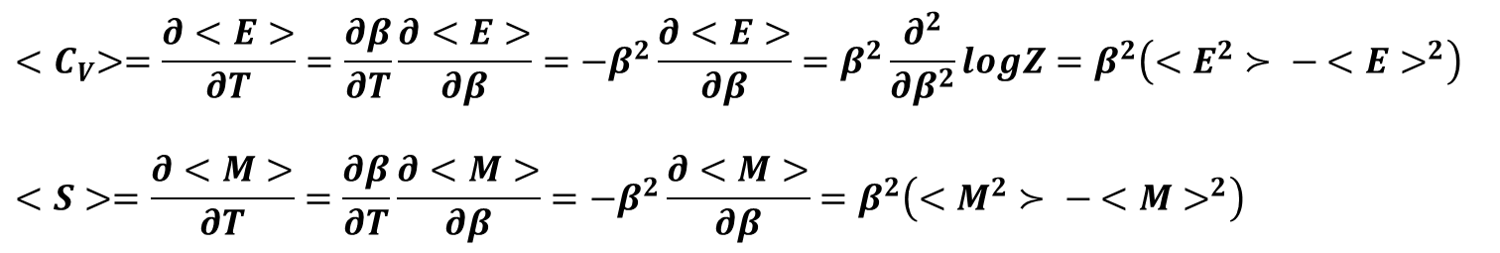
2. Numerical Solution in The One-Dimensional Ising Model
${{{hamiltonian H \text{=− }\text{J}\text{ (}\text{N}}_{++}\text{+} \text{N}}_{−−} \text{−} \text{N}}_{+−}{ \text{− }\text{N}}_{−+}$)
$$<E> =\frac{1}{N}\frac{1}{MC}<H>$$
${<M>=\frac{1}{N}\frac{1}{MC}| (N}_{+}− N_{−}$)|
$${<C}_{V}>=\frac{∂<E>}{∂T}=\frac{∂β}{∂T}\frac{∂<E>}{∂β}=−β^{2}\frac{∂<E>}{∂β}=β^{2}\frac{∂^{2}}{∂β^{2}}logZ=β^{2}\left(<E^{2}≻ − <E>^{2}\right)$$
$$<S>=\frac{∂<M>}{∂T}=\frac{∂β}{∂T}\frac{∂<M>}{∂β}=−β^{2}\frac{∂<M>}{∂β}=β^{2}\left(<M^{2}≻ − <M>^{2}\right)$$

Slide 18
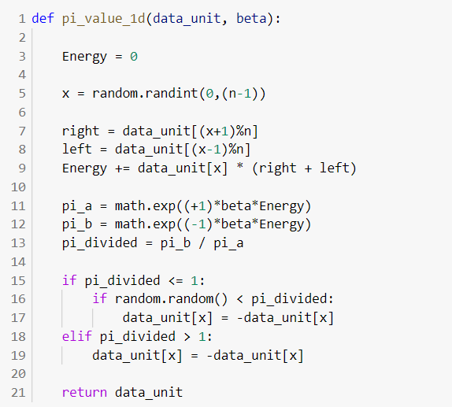
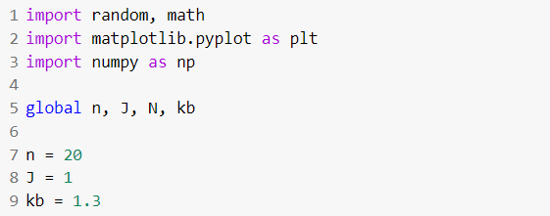
2. Numerical Solution in The One-Dimensional Ising Model
2-6. Python code
Fig. 2.6. python code – part1(import and define)
Fig. 2.7. python code – part1(make random matrix)
Fig. 2.8. python code – part3(flip)

Slide 19
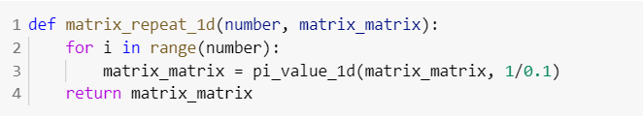
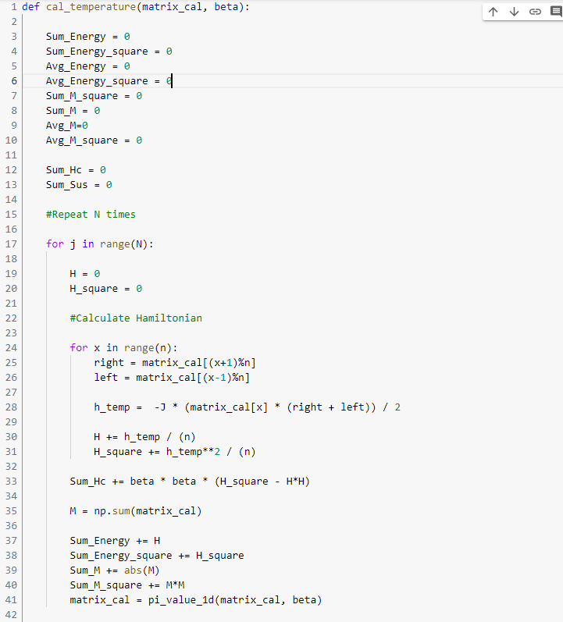
2. Numerical Solution in The One-Dimensional Ising Model
Fig. 2.9. python code – part3(repeat)
Fig. 2.10. python code – part3(caculate)

Slide 20
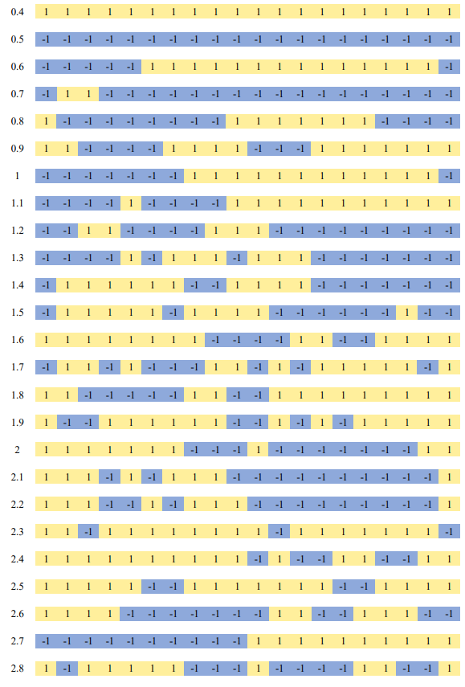
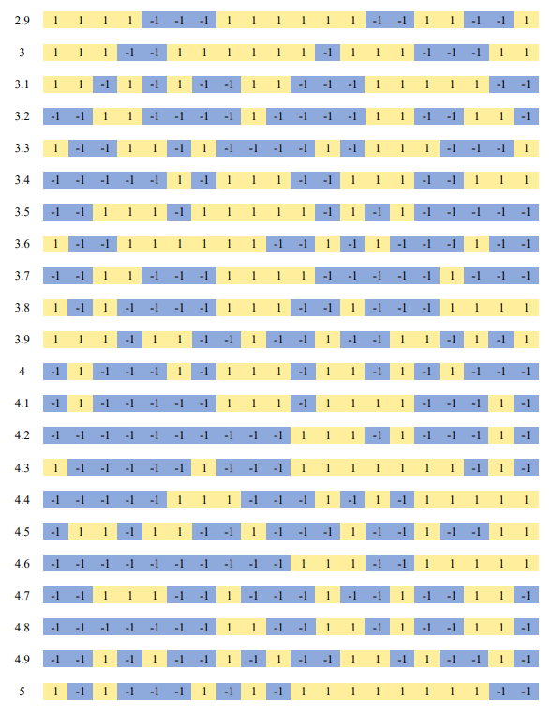
2. Numerical Solution in The One-Dimensional Ising Model
2-7. Result
T = 2.9
T = 0.4
T = 5
T = 2.8
Fig. 2.11.(b) distribution diagram
Fig. 2.11.(a) distribution diagram

Slide 21
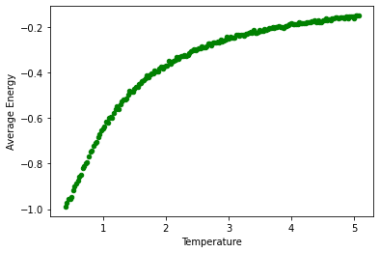
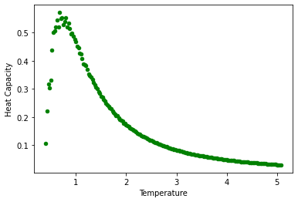
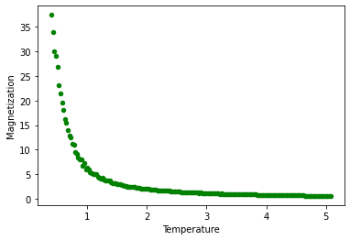
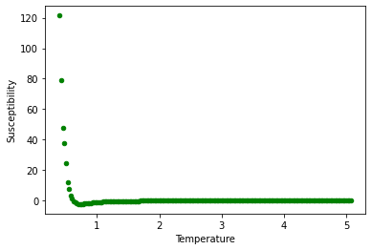
2. Numerical Solution in The One-Dimensional Ising Model
Fig. 2.12. Analytical solution graph in the one-dimensional Ising model

Slide 22
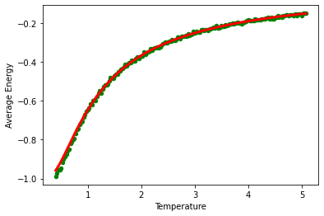
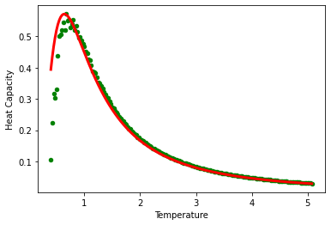


2. Numerical Solution in The One-Dimensional Ising Model
2-8. Comparison of Analytical and Numerical Solution
Fig. 2.13. Comparison of analytical and numerical solution graph in the one-dimensional Ising model

Slide 23
3. Reference
Daijiro Yoshioka: Statistical Physics (Springer, 2007)
David P.Landau & Kurt Binder: A guide to Monte Carlo Simulation in Statistical Physics Second Eddition (Cambridge, 2005)
Giuseppe Grosso, Giuseppe Pastori Parravicini:Solid State Physics (Second Edition 2014)
Werner Krauth: Statistical Mechanics: Algorithms and Computations (Oxford master series in physics, 2006)
Siddhartha Chib, Edward Greenburg: Understanding the Metropolis_Hastings Algorithm (The American Statistician, 1995)

